Slide 1
Transforming Trauma Informed Care: Integrating Historical Trauma in Behavioral Health and Primary Care
Jeanne Bereiter, MD
Maria Yellow Horse Brave Heart, PhD
Division of Community Behavioral Health
Department of Psychiatry and Behavioral Sciences
University of New Mexico Health Sciences Center
Albuquerque, NM

Slide 2
Disclosures
Drs. Bereiter and Brave Heart have no conflicts of interest with the material in this presentation.

Slide 3
Objectives
1. Integrate five core values of Trauma Informed Care into behavioral health and primary care.
2. Formulate examples of four Historical Trauma Response features and how they relate to complex trauma responses.
3. Assess the consequences of trauma on physical and behavioral health.
4. Summarize historical and cultural considerations in behavioral health treatment and primary care.

Slide 4
This Presentation Will Cover
Trauma informed care
Stress, ACES
Historical trauma, historical trauma response features

Slide 5
Trauma informed care

Slide 6
Trauma Informed Care Is…
Recovery oriented
Patient/client/consumer driven
Involves cultural humility/co-learning
Provides trauma specific services

Slide 7
Trauma Informed Paradigm
“What happened to this person?”
“What’s strong with you?”
Historical trauma informed:
“What tribal traumatic events happened over time?”
“What kind of school did you and family members attend?”
Standard Paradigm
“What’s wrong with this person?” “What’s wrong with you?”
NOT asking about collective tribal history
NOT asking about boarding school history or other tribal-specific experiences and culture

Slide 8
Human Services Relationship Standard Trauma-Informed
Hierarchical
Trust is assumed
Safety is assumed
Patient is passive recipient of services (or chooses from a menu)
Collaborative
Trust is developed over time
Steps are taken to ensure safety
Patient is encouraged/skills developed to express choice

Slide 9
What is Historical Trauma Informed Care?
Understanding the importance of cross generational and ancestral ties in tribal communities and families
Addressing cultural norms for addressing trauma and healing, traditional bereavement
Examining the collective traumatic tribal history as well as traditional cultural wisdom and resilience

Slide 10
5 Principles of Trauma-Informed Care (modified from CCTIC)
Safety
Trustworthiness
Making tasks clear
Maintaining appropriate boundaries
Choice
Prioritizing consumer choice and control
Collaboration
Between clinicians and consumers
Emphasizing working together on goals, not top down
Encouragement
Recognizing strengths
Skill building
Notes:
Safety-physical and emotional
Trustworthiness-making tasks clear, maintaining appropriate boundaries
Choice-prioritizing consumer choice and control
Collaboration-between clinicians and patients, emphasizing working together on goals, not top down
Encouragement-recognizing strengths, skill building

Slide 11
Creating a Safe Context-Emotional Safety
Are staff, patients, and providers able to speak up?
Is the system/people in it perceived as trustworthy?
How are patients greeted at the door?
Are boundaries clear and consistent?
Transparency
Confidentiality
Including contact with relatives e.g. sensitivity to potentially unsafe situations such as domestic violence, substance use
Predictability
Is spiritual safety considered?
Notes:
Are rules and reasons for them explained?
How are records accessed by patients?
Are confidentiality and limits to confidentiality explained?
How is personal information shared?
Roles and responsibilities of staff, providers, patients
Predictability: provide routine, don’t change provider working with patient

Slide 12
Ways to Help Sense of Emotional Safety
Calm, slow voice
Non judgmental language
Explain need for obtaining sensitive information
Explain everything you are asking/doing before doing it
Ensure private space for interview/examination
Consider patient’s physical/emotional boundaries
Consider touch-it might be triggering

Slide 13
Language Has Meaning
English, tribal language
Consumer, client, patient, relatives
First name, last name
Trauma survivor, cancer survivor, incest survivor
Doctor, physician, clinician, therapist, counselor, provider, prescriber
Empowerment, encouragement
Control
The way we talk to patients
Open ended versus close ended questions
“You shouldn’t, you can’t”
Do we explain symptoms in a culturally appropriate/understandable way?

Slide 14
Trauma Informed Reminders
Trauma reactions can be triggered by sudden loud sounds, tension between people, certain smells, casual touches
Exposing one’s history can manifest in the client as feeling vulnerable and unsafe.
Sudden treatment transitions or changing provider, can evoke feelings of abandonment
Trauma survivors generally value routine and predictability.
Strive to maintain a soothing, quiet demeanor. Clients who have been traumatized may be more reactive even to benign or well-intended questions.

Slide 15
Trustworthiness
Consider patients/relatives trust/lack of trust with IHS
Discuss ways patient/relatives might mistrust the provider
How is conflict of interest handled?
How is sensitive information protected/shared?
How are dual relationships handled?
How are boundaries protected?
Is there conflict with your agency and tribal leadership on decision making and care plans?
How is the informed consent process handled?
Appropriate to patient’s language, culture?

Slide 16
Choice
Are patients able to choose
Their treatment provider?
Time/date of follow up appointments?
Type of treatment?
Who comes to appointments with them?
Location of services?
Emergency management?
Involvement in their care plan?
Notes:
Emergency management E.g. advance directives, psychiatric advance directives

Slide 17
Maximizing Patient Choice
Communicate clearly about:
Treatment options and choices
Limitations of services
Patient rights and responsibilities
Any contingent services and why they are contingent on participation in other services
Build in “small” choices
When and how to communicate with patient (phone, mail)
Who can attend appointments with patient/receive information about patient

Slide 18
Collaboration
How can we do with rather than do for or do to?
Is patient life experience and history respected?
Awareness of strengths and skills?
Awareness that patient/relative is the ultimate expert on their own experience
Encourage patient/relative to collaborate
Identify tasks they can work on with provider e.g. information gathering
Are treatment plans decided upon collaboratively?

Slide 19
Use of Peers
Involve peers in the organizational structure
Develop peer support services

Slide 20
Encouragement
Respect patient/relatives wisdom and encouraging skill building
What is patient/relatives understanding of what they need/what service are they seeking?
How are patients asked about their strengths?
How is realistic optimism communicated?
What does the program do if the patient doesn’t reach their goals?
How does the program foster the involvement of patient/relatives?

Slide 21
Staff Support and Well-Being
Support and care for entire staff
Follows the same 5 principles as used with patients:
Safety, trustworthiness, choice, collaboration, encouragement
In order to care for others we need to function well ourselves
Able to teach, role model, not be reactive, self-controlled, never abuse power
Minimize vicarious/secondary trauma
Remember the Ethics of Self-Care

Slide 22
Staff Safety
Do staff feel physically safe at work?
Do staff feel comfortable bringing their concerns to team meetings, supervision?
Is it safe for IHS staff to talk about the difficulties of working in HIS?
Does the program provide training for staff on issues of transference, counter transference, cultural formulation from a provider stance?

Slide 23
Staff Training
Does the program train non native staff about culture?
Do staff feel comfortable talking about culture? Blind spots?
Does the program train on the concept of internalized depression?
Does the program train on trauma, including the impact of workplace stressors?
Do staff feel spiritually safe? Is there opportunity for spiritual cleansing?

Slide 24
Community Partnerships
Key part of trauma informed care
Form partnerships between your agency and the community:
Police
First responders
Other medical and behavioral health organizations
Spiritual leaders, healers, churches, schools
Promotes safe communities
Decreases trauma in communities

Slide 25
Culture Shift
Incorporate knowledge about trauma into all aspects of services
Not just for patients we know have experienced trauma
Minimize re-victimization
Do no harm/ non maleficence
Awareness that the service system (IHS, medical, dental) has been re-traumatizing to people

Slide 26
Steps to Creating a Trauma Informed System
Culture shift
Involves everyone: administrators, supervisors, line staff, clinicians, patients, families
Begin with small steps
Use the same principles we use with patients
Notes:
Safety, trustworthiness, choice, collaboration, encouragement

Slide 27
Stress

Slide 28
Acute Stress
Our bodies are designed to deal with acute stress
Fight/flight/freeze reaction is initiated
This stress response system increases our ability to survive danger
Once stress is over systems return to normal (homeostasis) via negative feedback loops
Notes:
Autonomic nervous system (ANS) activated:
Release of adrenaline (epinephrine)
Increased sympathetic tone causes dry mouth, increased HR, RR, BP, increased muscle tone
Digestion is inhibited
Hypothalamic-pituitary-adrenal (HPA) axis HPA axis activated:
CRH and AVP released from hypothalamus, bind to anterior pituitary, releases ACTH, acts on adrenals to release glucocorticoid (cortisol)
Cortisol promotes mobilization of stored glucose (for energy), decreases immune function (decreases inflammation)
Endorphins released =decreased sense of pain
Oxytocin increased

Slide 29
Chronic Stress
Our bodies are not designed to deal with persistent stress
Same systems are activated as in acute stress, but are activated over and over
This has adverse effects:
Initial high levels of cortisol then blunted corticosteroid release
Brain changes (high levels of cortisol are toxic)
Impairs neural plasticity, damages the hippocampus which impairs memory
Epigenetic changes
leads to increased risk of physical and psychiatric illness
Notes:
may react to their world even when the dangers are NOT present because they cannot turn off the survival strategies in their brains.

Slide 30
Epigenetics and Stress/Trauma
Gene expression is influenced by experience/environment
Stress and trauma affect gene expression
Epigenetics shows how stress/trauma can affect biological systems on a molecular level, leading to disease
Historical trauma can affect subsequent generations via epigenetics
Epigenetic changes can be reversed
Notes:
Alleles vary the sensitivity of stress hormone receptors in the limbic system, making the body’s stress response system more sensitive
Usually, epigenetic markers or “tags” are erased during gametogenesis, so the embryo starts out “fresh”
However, 1% of these markers in epigenome may not be erased, and are transmitted to the embryo
Explains why we haven’t been able to find many 1 gene=1 disease models, but more often that a gene leads to increased susceptibility
Epigenetics provides the rationale why identical twins don’t get identical diseases
Twins at a young age have very similar genes and when older have many different epigenetic markers
Poor diet can lead to epigenetic markers that are transmitted, leading to increased risk of diabetes in offspring, for example
Research has shown transmission to next generation in animal models, not quite proven yet in humans
Good news: an enriched environment can modulate the epigenome

Slide 31
Epigenetics, Transgenerational Effects, and PTSD
Transgenerational, higher stress vulnerability (doesn’t mean poor mental health necessarily but greater risk for traumatic responses to stress and more likely to have PTSD-like symptoms)
Stressful environmental conditions can leave a genetic imprint, changes in neurobiology
Testimonies of “inherited” grief in qualitative research

Slide 32
Adverse childhood experiences (ACES)

Slide 33
ACE (Adverse Childhood Experience) Study
Looked at the relationship between childhood abuse and neglect and later-life health and well-being
Original ACE study done from 1995-1997 at Kaiser Permanente in S California in collaboration with US CDC
Surveyed 17,000+ HMO members who completed a confidential survey given to them when they came for their physical exam
70% Caucasian
70% college educated

Slide 34
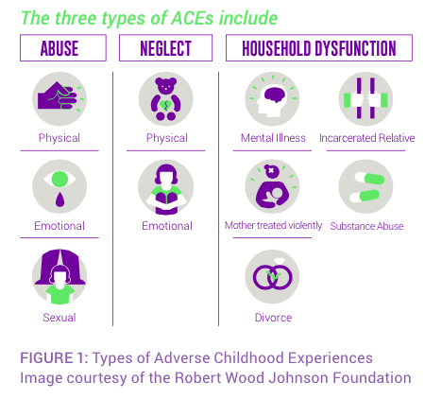
Slide 46

Slide 35
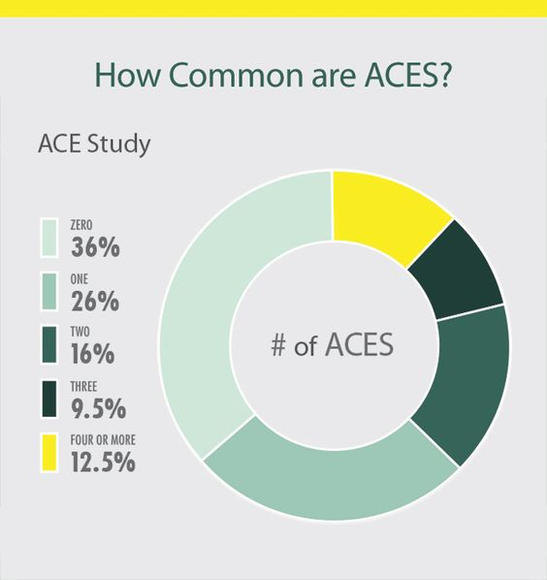
Slide 47

Slide 36
Major Findings
64% reported at least one ACE
1in 8 people had 4+ ACEs
Relative risk for multiple physical, mental health and psychosocial outcomes increased with number of ACEs
Risk increases even if people don’t engage in high risk behaviors such as smoking, drug or alcohol use

Slide 37
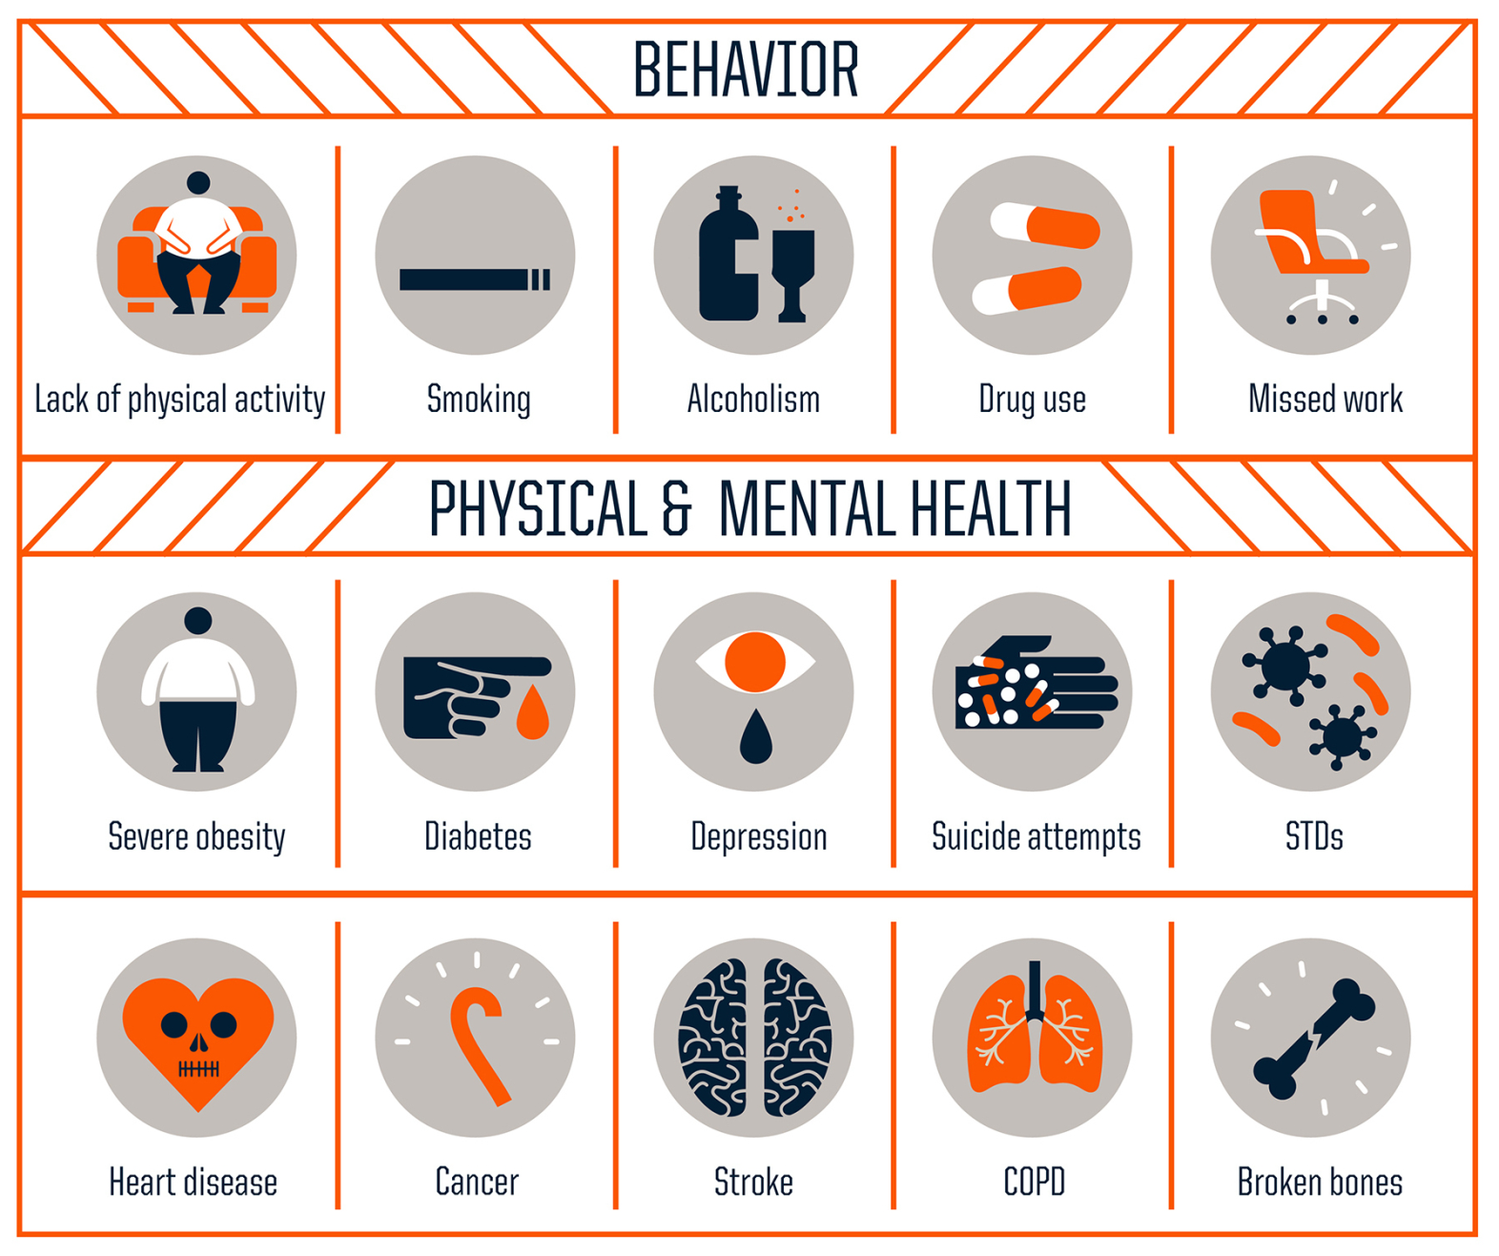
Slide 49
Notes:
Increasing ACEs cause increased likelihood of all of these…find bull riding study

Slide 38
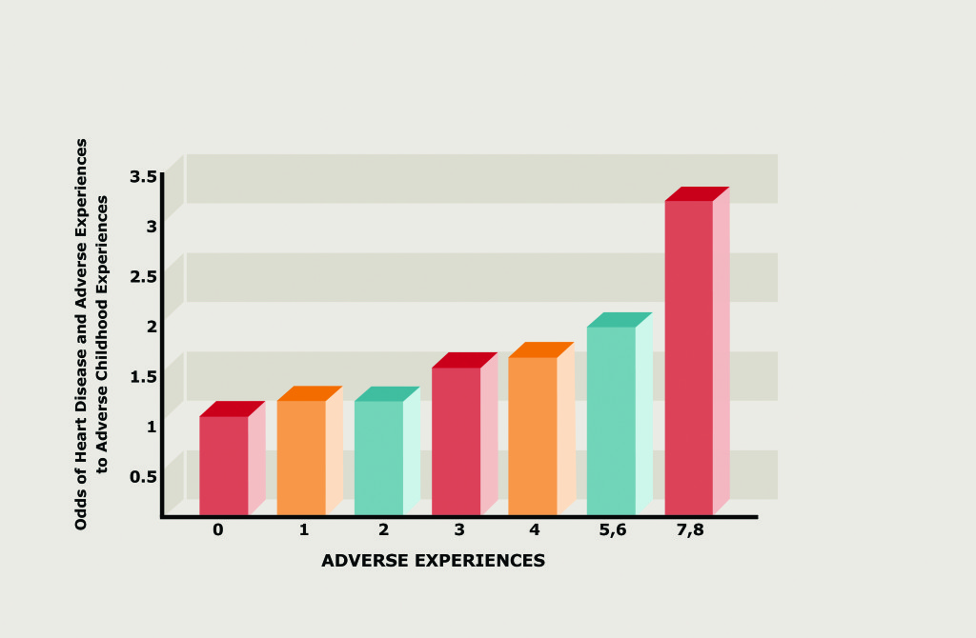
Odds of Heart Disease With Increasing Aces
Notes:
Same table could be drawn for smoking, depression, obesity, work absenteeism, etc.

Slide 39
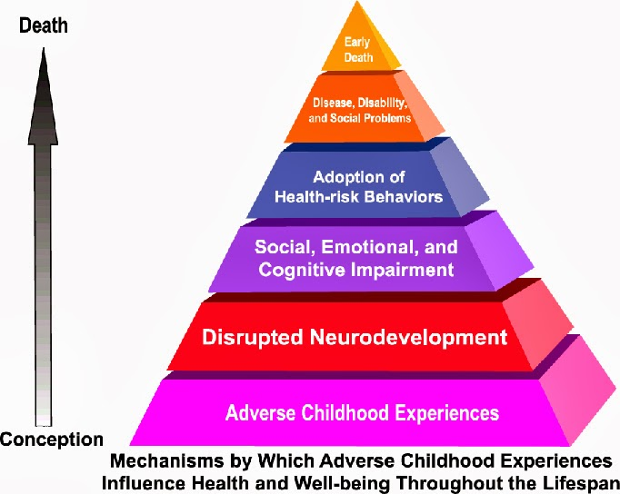
Slide 51

Slide 40
ACE Scores Among AI/AN children compared with non Hispanic white children
AI/AN
NHW
2+ACEs 40.3%
3+ ACEs 26.8%
4+ ACEs 16.8%
5+ ACEs 9.9%
Once adjusted for sociodemographic variables, the differences between the 2 populations went away
21%
11.5%
6.2%
3.3%
Notes:
Examined parent reported ACEs from the 2011-2012 National Survey of Children’s Health. (CDC telephone survey.) 1,453 AI/AN 0–17-year-olds and a comparison group of 61,381 NHW children. Looked at 9 ACEs: difficulty affording food or housing, lived with parent who divorced/separated, lived with parent who dies, lived with parent who served time in jail, seen domestic violence in parents, been a victim of neighborhood violence or witnessed it, lived with anyone who was mentally ill or depressed, lived with anyone with drug/alcohol problems, been treated unfairly based on race/ethnicity
LINK WITH BEALS-MARIA

Slide 41
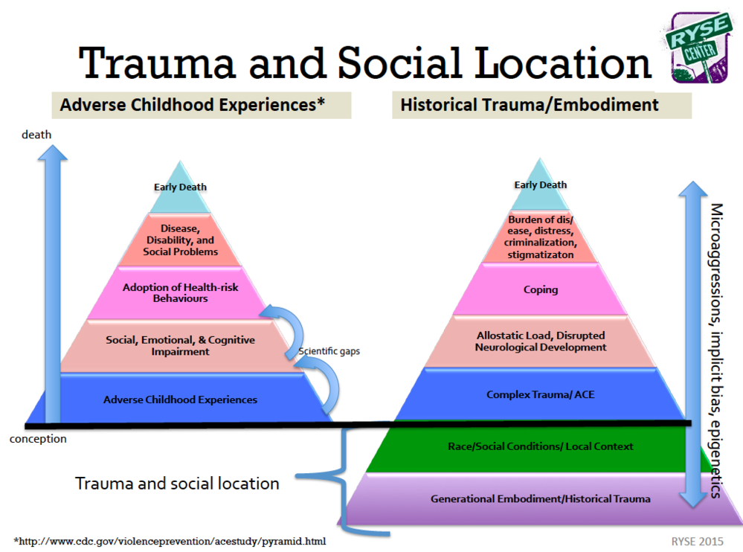
Slide 54

Slide 42
Effects of Childhood Abuse on Healthcare Behaviors
Avoidance of care
Decreased access of pap smears and mammography
Delay in seeking treatment
Decreased adherence to treatment
Avoidance can be related to fear and complex identification issues, behavioral health issues, with family members who have or died from an illness
Overutilization of care
Trauma reactions while receiving medical care

Slide 43
Trauma-Specific Treatments
Trauma focused cognitive behavioral therapy (CBT)
Dialectical Behavioral Therapy (DBT)
Eye movement desensitization and reprocessing (EMDR)
Prolonged Exposure
Treatment for historical trauma e.g. HTUG
Psychodynamic therapy
Pharmacotherapy
Traditional healing

Slide 44
Trauma-Specific Treatments-continued
Body therapies “sensorimotor”
Breathing techniques
Acupuncture
Exercise
Rhythmic activities- drumming, dancing
Mindfulness meditation
Massage
Neurosequential model of therapeutics
Hakomi therapy
Equine therapy

Slide 45
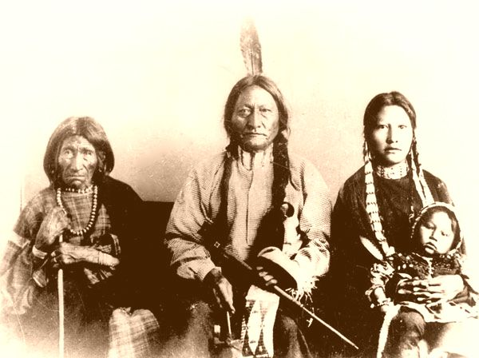
Historical Trauma: Implications for Trauma Informed Care and Healing

Slide 46
Example of Traditional Cultural Perspectives on Collective Trauma and Grief
It is our way to mourn for one year when one of our relations enters the Spirit World...tradition is not to be happy, not to sing and dance and enjoy life’s beauty during mourning time….to suffer with the remembering of our lost one…. And for one hundred years we as a people have mourned our great leader… blackness has been around us for a hundred years. During this time the heartbeat of our people has been weak, and our life style has deteriorated to a devastating degree. Our people now suffer from the highest rates of unemployment, poverty, alcoholism, and suicide in the country.*
*From a booklet for the Sitting Bull and Bigfoot Memorial Ride; Traditional Hunkpapa Lakota Elders Council (Blackcloud, 1990)

Slide 47
Intergenerational Parental Trauma
I never bonded with any parental figures in my home. At seven years old, I could be gone for days at a time and no one would look for me….I’ve never been to a boarding school....all of the abuse we’ve talked about happened in my home. If it had happened by strangers, it wouldn’t have been so bad- the sexual abuse, the neglect. Then, I could blame it all on another race….And, yes, they [my parents] went to boarding school.
A Lakota Parent in Recovery
(Brave Heart, 2000, pp. 254-255)

Slide 48
Ongoing Cumulative Losses and Trauma Exposure
Intergenerational parental trauma traced back to legacy of negative boarding school experiences
Constant trauma exposure related to deaths from alcohol-related incidents, suicides, heart disease, diabetes, cancer, etc., and constant state of mourning
Surviving family members include individuals who are descendants of massive tribal trauma (e.g. massacres, abusive and traumatic boarding school placement)
Cumulative trauma exposure – current and lifespan trauma superimposed on collective massive
American Indians have the highest military enlistment rate than any other racial or ethnic group – extends traumatic exposure

Slide 49
Definitions
Trauma results from event/circumstances experienced as physically or emotionally harmful or threatening with lasting adverse effects on the individual’s functioning and physical, social, emotional, or spiritual well-being*
Historical trauma - Cumulative emotional and psychological wounding from massive group trauma across generations, including lifespan
Historical trauma response (HTR) is a constellation of features in reaction to massive group trauma, includes historical unresolved grief (similar to other massively traumatized groups (Brave Heart, 1998, 1999, 2000)
* (Substance Abuse and Mental Health Services Administration. Trauma-Informed Care in Behavioral Health Services. Treatment Improvement Protocol (TIP) Series 57. HHS Publication No. (SMA) 13-4801)

Slide 50
Historical Trauma, Genocide and Survival: the Elephant in the Room
Congressional genocidal policy: no further recognition of their rights to the land over which they roam.…go upon said reservations…chose between this policy of the government and extermination….wards of the government, controlled and managed at its discretion (U.S. Senate Miscellaneous Document 1868 cited in Brave Heart, 1998)
BIA started under the War Department; BIA Education Division called “Civilization Division” & IHS evolved from BIA
Congressional policy of forced separation of children from family and tribe – early boarding school trauma
Honesty about this legacy and impact upon current relationships, mistrust, and strategies to move forward are part of trauma informed care

Slide 51
Ways HT May Be Transferred
Identification with and internalization of oppressor’s view, resulting in self-hatred, self-destructiveness
Identifying with parents’ trauma responses; other mechanisms of transfer across generations (epigenetic research may provide further insight)
Past prohibition against practice of traditional burials limited bereavement, complicating grief resolution
Active relationships with ancestor spirits and cultural attachment styles include death as a loss of part of self (e.g. exhibited by cutting the hair); without traditional culturally congruent mourning practices, grief could become impaired

Slide 52
Prevalence and Testimonies of HT
I think losing the land was the most traumatic….I remember my… dad talked about...how they were treated, some were shot…They were starved....So this happened in my great grandparents' generation when they lost the buffalo. My grandparents' generation lost the land and their livelihood....That's from generation to generation. There are a lot of answers that I don't have and a lot of questions that I do have and there is a lot of hurt inside me….Some of these things happening over the years are still happening today, like my grandparents, my great grandparents had their children moved to schools....I was moved, my brothers and sisters moved.…There's a big hole in my heart. We see it happening to our grandchildren already....Where does it stop? (Brave Heart, et al., 2012)
One-fifth to one-third of Indigenous adults reported thoughts pertaining to historical loss daily or several times a day, and that these thoughts have negative emotional consequences (Whitbeck et al., 2004).

Slide 53
Some Historical Trauma Response Features
Survivor guilt
Depression
PTSD symptoms
Psychic numbing
Fixation to trauma
Somatic (physical) symptoms
Self-destructive behavior including substance abuse
Suicidal ideation
Traditional cultural attachment
Death identity – fantasies of reunification with the deceased; cheated death
Preoccupation with trauma, with death
Loyalty to ancestral suffering & the deceased
Internalization of ancestral suffering
Vitality in own life seen as a betrayal to ancestors who suffered so much

Slide 54
Case Example
15 year old American Indian girl with recovering boarding school survivor parents attempts suicide – after a few therapy sessions, the girl reveals that she didn’t want to burden her parents with her problems because they have suffered so much from their boarding school trauma.
Video Clip: We Shall Remain by the StyleHorse Collective; Coeur d’Alene Tribal Youth Programs (see credits at end of the clip)
https://www.youtube.com/watch?v=Gs0iwY6YjSk

Slide 55

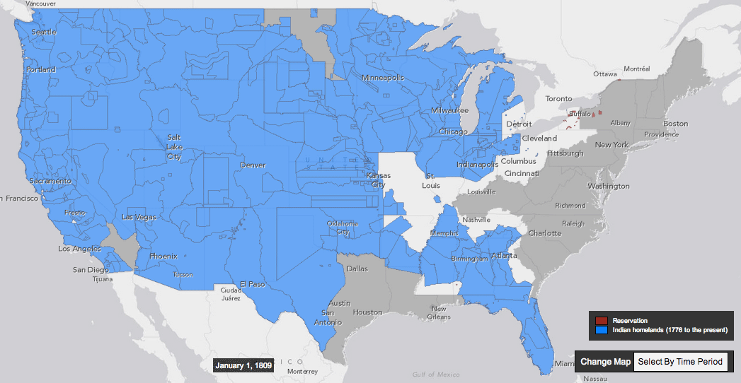

Setting the Stage
From: http://www.slate.com/blogs/the_vault/2014/06/17/interactive_map_loss_of_indian_land.html

Slide 56
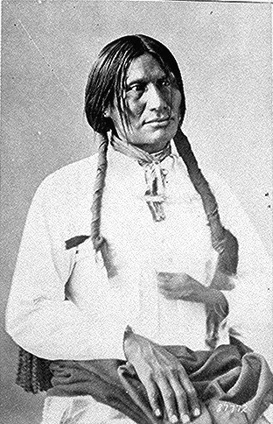
Tatanka Iyotake & Sitanka Wokiksuye Sitting Bull Memorial & Bigfoot Memorial Ride 1990 – 100 years later

Slide 57
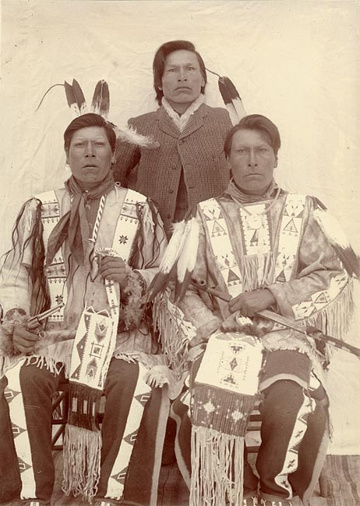
Takini

Slide 58
Spontaneous Testimonies at the End of the Four Days of the first HTUG in 1992
Sitanka Wokiksuye Rider – I sacrificed to wipe the tears of the people but until today, no one had wiped my tears
Expressions of transformative experience
We formed a kinship network
Own experience – further solidified my commitment to this sacred path; asked by Lakota elder to lead the people in this historical trauma healing work and have maintained this commitment
As therapists, providers, healers, we need to help to wipe our tears

Slide 59
Historical Trauma & Unresolved Grief Intervention: Return to the Sacred Path
Understanding
the Trauma
Releasing
Our Pain
Transcending the Trauma
Confronting Historical
Trauma & Embracing Our History
Return to
The Sacred
Path
Notes:
Return to the Sacred Path
Intervention focuses on collective communal healing
Healing methods based on spirituality, traditional cultural practices, combined with trauma theory
Focuses on individual and community
Culture & history foundation of HTR paradigm
Traditional culture & ceremonies throughout facilitate cathartic release of emotions
Psychoeducation; narratives & trauma testimony

Slide 60
Recognize & briefly describe the value of self-knowledge and how it enters into the treatment relationship
Identify ones own HT Response Features (HTR) and tribal as well as family and individual trauma history, vulnerabilities, potential trauma triggers
This can be done through ones own HT work, therapy, and supervision with a supportive supervisor and through peer supervision, and through ceremonies
Psychoanalytic principle – one cannot take someone further in treatment than one has gone themselves – so you must go through your own healing process in order to truly be helpful to your patients/clients, work through your own resistance (which is a normal part of therapy as well as being on a spiritual path or any path of growth and development)

Slide 61
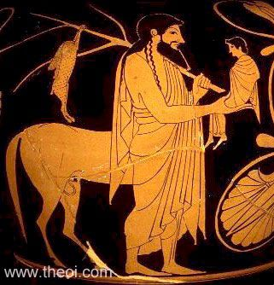
The Wounded Healer-Chiron
A centaur in Greek mythology
Accidentally wounded, in chronic severe pain, incurable
Renowned teacher and healer

Slide 62
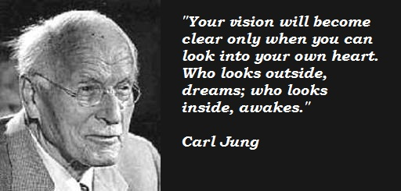
The Wounded Healer-Carl Jung
“the doctor is effective only when he himself is affected. Only the wounded physician heals.”
Developed the “wounded healer archetype”
Notes:
Swiss psychiatrist and psychoanalyst (1875-1961)

Slide 63
The Wounded Healer in AI/AN Tradition
AI/AN people are all trauma survivors
Historical trauma
Personal trauma
Many AI/N healers have had dreams and visions after surviving a physical illness
Illness was seen as part of the process for visions and receiving spiritual powers
Black Elk described in Black Elk Speaks receiving healing powers after an illness

Slide 64
Objective countertransference and induced countertransference
Important to attend to ones own thoughts, associations, feelings, where ones mind goes during sessions – clues to what is going on in treatment, how the patient/client might be feeling or something they may not be conscious of but that is important for the treatment
Unconscious communication – example from first microwave pizza – pay attention to where your mind may wander
Transference is the patient’s displacement or reenactment of feelings and dynamics with significant relationships, usually childhood relationships, particularly parents or caretakers.
Countertransference is the reaction of the therapist to the patient’s transference.

Slide 65
More about objective countertransference and induced countertransference
Objective countertransference – anyone would react similarly to the patient – feelings in the therapist are being induced. Feelings do not last long after the session. Staff at your clinic may also experience similar feelings towards the patient – this may be a clue.
Subjective countertransference - specific to therapist’s own reaction to patient’s behavior, communications, etc. Requires therapist’s deeper exploration in supervision and own therapy about what is getting triggered.
There could be an objective countertransference but may possibly also trigger subjective countertransference reactions based on therapist’s past relationships and issues.
Clues are thinking about patient a lot outside of sessions, more than other patients, feeling irritated or angry, etc.

Slide 66
Historical Trauma Response Features – may come up in countertransference reactions towards patient such as:
Survivor guilt
Depression
Sometimes PTSD symptoms
Psychic numbing
Somatic (physical) symptoms
Low self-esteem
Victim Identity
Anger
Hypervigilance
Dissociation
Compensatory fantasies
Poor affect (emotion) tolerance

Slide 67
Some techniques to develop self-awareness and integrate it into trauma informed treatment
Journaling
Peer supervision groups
Request regular individual supervision and try using a psychodynamic supervision approach of focusing on two cases in depth – goal is to generalize learning to all cases
Advocate for supervisory safety – trauma informed – and perhaps arrange for a separate clinical supervisor from administrative supervisor
Private supervision arrangements
Advanced training programs, post-graduate institutes, peer support group, and some online therapists collectives
Literature on the wounded healer – good resources
Change the culture of your site – talk more openly about “wounded healers” and that we are all survivors of wounding
Clinical consultation groups – one starting now supported by IHS

Slide 68
Wakiksuyapi (Memorial People)
Takini Network/Institute as Wakiksuyapi, carrying the historical trauma but working on healing
For the Lakota, specific tiospaye (extended kinship network) or bands may carry the trauma for the Nation, i.e. those most impacted by Wounded Knee Massacre
We are descendants of traditional warriors and survivors, including 1890 Wounded Knee Massacre descendants; we are children of World War II Marine, Army, and Navy veterans; Takini includes Vietnam veterans and involving Korean War, OEF/OIF veterans
Our awareness of being Wakiksuyapi in process of healing is important for effectiveness as therapists and healers

Slide 69
DSM Cultural Formulation: Some Content Specific to Countertransference
Cultural elements of the relationship between the individual and the clinician
Individual differences in culture & social status between the individual & clinician
Problems these differences may cause
Similarities may also be challenging – example working with a male Marine veteran and my own relationship with my deceased Marine father – and a Marine relative killed in Iraq - need for heightened awareness of countertransference issues
Cultural Identity
Ethnic or cultural reference group(s)
Degree of involvement w/culture of origin & host culture
Language abilities, use, & preference
Adding tribal military culture in this consideration

Slide 70
Culturally Sensitive Diagnosis: the DSM Cultural Formulation
Overall cultural assessment for diagnosis and care
Discussion of how cultural considerations specifically influence comprehensive diagnosis and care
Reference:
Lewis-Fernandez, R. and Diaz, N. The Cultural Formulation: A method for assessing cultural factors affecting the clinical encounter. Psychiatric Quarterly, 2002, 73(4): 271-295. (Table 1, p. 275)
*******************************************************************
Examples for Native clients: skin color issues, risk for trauma exposure, traditional mourning practices, racism, unemployment rates, housing availability

Slide 71
Trauma Informed Supervision – Awareness is Key!
We bring our past into the workplace – not conscious
We often reenact our family dynamics and traumatic histories in work and personal relationships [unconscious attempt to recreate and master trauma]
We get triggered may have compassion fatigue
Supervision as a parallel process – for behavioral health providers, as we present a case we unconsciously bring in dynamics with the patient into the supervision– this is normal! Understanding this and using this in supervision help in comprehending the dynamics of a case and the therapeutic relationship
Importance of self-care and attending to ones own trauma history and work those through – owe it to our patients and ourselves!
Notes:
Safety, trustworthiness, choice, collaboration, encouragement

Slide 72
Complex Trauma
Not a DSM 5 diagnosis but planned for inclusion in ICD-11
DSM IV field trial showed that 92% of people with complex PTSD/Complex Trauma also met diagnostic criteria for PTSD
PTSD doesn’t cover the intricacy of complex trauma nor historical trauma
Found in people who have experienced multiple, chronic or prolonged traumas
Complex trauma congruent with Historical Trauma Response but HTR includes generational prolonged and repeated trauma exposure
Symptoms may include dissociation, anger, depression, change in self concept, change in response to stressful events, irritability, frozen/restricted, flashbacks, altered perceptions/beliefs – similar to features of HTR

Slide 73
Complex Trauma and Historical Trauma
Complex trauma - prolonged, repeated trauma in which the person was “in a state of captivity” physically or emotionally (Herman, 1997).
Early reservation days and POW designation for some tribal groups, massacres, colonization, forced separation of children from families and tribe, may be emotionally experienced as a legacy of living in a state of captivity.
Treatment involves need for person to regain sense of control and power, and work in interpersonal relationships – many AIAN face repeated disruption in sense of agency and experiences collectively of powerlessness related to past and ongoing oppression, e.g. DAPL which has been triggering for AIAN

Slide 74
Vicarious or Secondary Trauma
Experienced by healthcare providers
Patients ill and dying
Hearing stories of medical trauma
Experiencing historical trauma themselves
Experiencing trauma themselves
Experienced by behavioral health providers
Hearing stories of trauma from their clients
Experiencing historical trauma themselves
Experiencing trauma themselves
Notes:
Can also be a primary trauma, e.g. your actions resulting in a patient’s death.
Hearing patients’ stories can trigger memories of our own trauma
Administrators, supervisors, front desk, kitchen, janitorial staff can also be traumatized

Slide 75
Trauma informed supervision
Bringing ones past into the workplace
Getting triggered, compassion fatigue, addressing self-care
Supervision as a parallel process – when presenting a case, supervisor may start experiencing similar feelings that supervisee had in the clinical session or feelings that the patient may have had. Good to examine these – helpful to understanding the case
Importance of self-care
Notes:
Safety, trustworthiness, choice, collaboration, encouragement

Slide 76
Trauma Informed Use of Self, Transference and Countertransference
Trauma narratives of patients will be triggering particularly if therapist has own trauma history.
Developing comfort with one’s own reactions and working on healing from one’s own trauma is essential.
Awareness of trauma is helpful rather than harmful (avoidance is worse as one can “act out” by not listening to the patient, shutting down emotionally, becoming judgmental, and interfering with the patient’s healing)
Trauma informed care includes addressing providers own needs and healing. Review information on Secondary, Vicarious Trauma, Compassion Fatigue, and Burnout

Slide 77
Complex Trauma
Not a DSM 5 diagnosis but planned for inclusion in ICD-11
DSM IV field trial showed that 92% of people with complex PTSD/Complex Trauma also met diagnostic criteria for PTSD
PTSD doesn’t cover the intricacy of complex trauma
Found in people who have experienced multiple, chronic or prolonged traumas
Complex trauma congruent with Historical Trauma Response but HTR includes generational prolonged and repeated trauma exposure
Symptoms may include dissociation, anger, depression, change in self concept, change in response to stressful events, irritability, frozen/restricted, flashbacks, altered perceptions/beliefs – similar to features of HTR

Slide 78
Culturally & Historically Responsive Assessment
Explore generational boarding school history, tribal traumatic events, and how these were/are processed
Explore degree of involvement in traditional Indigenous culture
Consider tribal relocations, migration, trauma in tribal community of origin, language
Attend to cultural explanation of symptoms, preferences for sources of care, including traditional healing
Role of spiritual practices & kin networks in providing support
Other issues: skin color (potential for increased risk for discrimination and race-related trauma exposure), traditional mourning practices, unemployment rates, housing availability
Individual differences in culture & social status between the individual & clinician and potential impact upon care
Utilize DSM Cultural Formulation in ALL behavioral health assessments

Slide 79
Cultural Formulation (cont.) specific to AIAN
Indirect styles of communication, values of non-interference and non-intrusiveness, & polite reserve may delay help-seeking and true presenting problem
Variation in eye contact; cultural differences in personal space & cross-gender interaction
Listening for the meaning in the metaphor
Client use of narratives, stories; talking in the displacement
Beginning phase may be longer

Slide 80
The Ethics of Self-Care: Standards of self-care guidelines:
• Respect for the dignity and worth of self: A violation lowers your integrity and trust.
• Responsibility of self-care: Ultimately it is your responsibility to take care of yourself—and no situation or person can justify neglecting this duty.
• Self-care and duty to perform: the duty to perform as a helper cannot be fulfilled if there is not, at the same time, a duty to self-care
Source: Green Cross Academy of Traumatology, 2010
Challenges for AIAN providers or providers from traumatized populations – spiritual and cultural commitments to helping can present challenges for self-care – we sometimes carry the trauma of our tribal communities and ancestors

Slide 81
HTUG Development & the Takini Network/Institute 1980s-2017 Tunkasila Tatanka Iyotake, Mother Her Holy Door, Daughter, and Grandchild

Slide 82
Historical Trauma and Unresolved Grief Intervention
HTUG facilitates: (1) not being alone in depression; (2) reduction of stigma through the emphasis on the collective context (3) decrease in depression;
Research team members/providers dealing with own HT and ongoing family and community trauma;
Traditional tribal culture as protective factors;
Participants’ testimonies of perceived positive response to interventions and not having had an opportunity to address HT before

Slide 83
Historical Trauma Intervention Research & Evaluation: Qualitative Evaluation of Parental Responses
Increased sense of parental competence
Increase in use of traditional language
Increased communication with own parents and grandparents about HT
Improved relationships with children, parents, grandparents, and extended kinship network
Increased pride in being Lakota and valuing own culture, i.e. Seven Laws

Slide 84
Websites
ACES Connection
http://www.acesconnection.com/
ACES Too High
www.acestoohigh.com
International Society for Traumatic Stress Studies (ISTSS)
www.istss.org
The National Council for Behavioral Health
https://www.thenationalcouncil.org/topics/trauma-informed-care/
National Child Traumatic Stress Network (NCTSN)
http://www.nctsn.org/

Slide 85
Websites-continued
PTSD: National Center for PTSD (US Department of Veterans Affairs)
https://www.ptsd.va.gov/
SAMHSA National Center for Trauma-Informed Care and Alternatives to Seclusion and Restraint (NCTIC)
https://www.samhsa.gov/nctic
SAMHSA National Child Traumatic Stress Initiative (NCTSI)
https://www.samhsa.gov/child-trauma

Slide 86
References
Anda, R. F., Felitti, V. J., Bremner, J. D., Walker, J. D., Whitfield, C., Perry, B. D., … Giles, W. H. (2006). The enduring effects of abuse and related adverse experiences in childhood: A convergence of evidence from neurobiology and epidemiology. European Archives of Psychiatry and Clinical Neuroscience, 256(3), 174–186. http://doi.org/10.1007/s00406-005-0624-4
Bremness, A., & Polzin, W. (2014). Commentary: Developmental Trauma Disorder: A Missed Opportunity in DSM V. Journal of the Canadian Academy of Child and Adolescent Psychiatry, 23(2), 142–145.
Brockie, T. N., Heinzelmann, M., & Gill, J. (2013). A Framework to Examine the Role of Epigenetics in Health Disparities among Native Americans. Nursing Research and Practice, 2013, 410395. http://doi.org/10.1155/2013/410395

Slide 87
References-2
Felitti, V., Anda, R., Nordenberg D., Williamson, M, Spitz, A., Edwards, V., Koss, M.,Marks, J. Relationship of childhood abuse and household dysfunction to many of the leading causes of death in adults: The Adverse Childhood Experiences (ACE) Study. American Journal of Preventive Medicine, 1998, 14:245-258
Figley, C.R. (ed.) (1995) Compassion Fatigue: Secondary Traumatic Stress Disorders from Treating the Traumatized, NY Brunner-Mazel
Kirsten Havig (2008) The Health care Experience of Adult Survivors of Child Sexual Abuse, Trauma, Violence, and Abuse Vol9, Issue 1, pp 19-33

Slide 88
References 3
(Herman, J. (1997). Trauma and recovery: The aftermath of violence from domestic abuse to political terror. New York: Basic Books. )
Mary Kay Kenney and Gopal K. Singh, “Adverse Childhood Experiences among American Indian/Alaska Native Children: The 2011-2012 National Survey of Children’s Health,” Scientifica, vol. 2016, Article ID 7424239, 14 pages, 2016. doi:10.1155/2016/7424239
Natalie J. Sachs-Ericsson, Nicole C. Rushing, Ian H. Stanley, and Julia Sheffler In my end is my beginning: developmental trajectories of adverse childhood experiences to late-life suicide, Aging & Mental Health Vol. 20 , Iss. 2,2016
Pechtel, P., & Pizzagalli, D. A. (2011). Effects of Early Life Stress on Cognitive and Affective Function: An Integrated Review of Human Literature. Psychopharmacology, 214(1), 55–70. http://doi.org/10.1007/s00213-010-2009-2

Slide 89
References-4
Yehuda & Bierer, (2009) J of Traumatic Stress, 22 (5)
Yehuda, et al., (2005) J of Clinical Endocrinology & Metabolism, 90 (7)
Walters et al., (2011) Du Bois Review: Social Science Research on Race, 8(1)

Slide 90
Relevant Recent HT Publications
Brave Heart, M.Y.H., Elkins, J., Tafoya, G., Bird, D., & Salvador (2012). Wicasa Was'aka: Restoring the traditional strength of American Indian males. American Journal of Public Health, 102 (S2), 177-183.
Brave Heart, M.Y.H., Chase, J., Elkins, J., & Altschul, D.B. (2011). Historical trauma among Indigenous Peoples of the Americas: Concepts, research, and clinical considerations. Journal of Psychoactive Drugs, 43 (4), 282-290.
Brave Heart, M.Y.H. & Deschenie, T. (2006). Resource guide: Historical trauma and post-colonial stress in American Indian populations. Tribal College Journal of American Indian Higher Education, 17 (3), 24-27.
Brave Heart, M.Y.H. (2003). The historical trauma response among Natives and its relationship with substance abuse: A Lakota illustration. Journal of Psychoactive Drugs, 35(1), 7-13.

Slide 91
Relevant Recent HT Publications
Brave Heart, M.Y.H., Elkins, J., Tafoya, G., Bird, D., & Salvador (2012). Wicasa Was'aka: Restoring the traditional strength of American Indian males. American Journal of Public Health, 102 (S2), 177-183.
Brave Heart, M.Y.H., Chase, J., Elkins, J., & Altschul, D.B. (2011). Historical trauma among Indigenous Peoples of the Americas: Concepts, research, and clinical considerations. Journal of Psychoactive Drugs, 43 (4), 282-290.
Brave Heart, M.Y.H. (2003). The historical trauma response among Natives and its relationship with substance abuse: A Lakota illustration. Journal of Psychoactive Drugs, 35(1), 7-13.
Evans-Campbell T, Lindhorst T, Huang B, Walters KL (2006) Interpersonal violence in the lives of urban American Indian and Alaska Native women: implications for health, mental health, and help-seeking. Am J Public Health 96(8):1416–1422. doi:10.2105/ AJPH.2004.054213

Slide 92
References-Brave Heart
Brave Heart, M.Y.H., Lewis-Fernández, R, Beals, J, Hasin, D, Sugaya, L, Wang, S, Grant, BF., Blanco, C. (2016). Psychiatric Disorders and Mental Health Treatment in American Indians and Alaska Natives: Results of the National Epidemiologic Survey on Alcohol and Related Conditions. Social Psychiatry and Psychiatric Epidemiology, 51 (7), 1033-1046.
Brave Heart, M.Y.H., Chase, J., Elkins, J., Nanez, J., Martin, J., & Mootz, J. (2016). Women finding the way: American Indian women leading intervention research in Native communities. American Indian and Alaska Native Mental Health Research Journal 23 (3), 24-47.
Brave Heart, M.Y.H., Bird, D.M., Altschul, D., & Crisanti, A. (2014). Wiping the tears of American Indian and Alaska Native youth: Suicide risk and prevention. In J.I. Ross (Ed.), Handbook: American Indians at Risk (pp. 495-515). Santa Barbara, CA: ABC- CLIO Greenwood.

Slide 93
References-Brave Heart-continued
Brave Heart, M.Y.H. (1999) Oyate Ptayela: Rebuilding the Lakota Nation through addressing historical trauma among Lakota parents. Journal of Human Behavior and the Social Environment, 2(1/2), 109-126.
Brave Heart, M.Y.H. (2000) Wakiksuyapi: Carrying the historical trauma of the Lakota. Tulane Studies in Social Welfare, 21-22, 245-266.
Brave Heart, M.Y.H. (2001) Clinical assessment with American Indians. In R.Fong & S. Furuto (Eds), Cultural competent social work practice: Practice skills, interventions, and evaluation (pp. 163-177). Reading, MA: Longman Publishers.
Brave Heart, M.Y.H. (2001) Clinical interventions with American Indians. In R. Fong & S. Furuto (Eds). Cultural competent social work practice: Practice skills, interventions, and evaluation (pp. 285-298). Reading, MA: Longman Publishers.

Slide 94
References-Brave Heart continued
Beals, J., Manson, S., Whitesell, N. Spicer, P., Novins, D. & Mitchell, C. (2005). Prevalence of DSM-IV disorders and attendant help-seeking in 2 American Indian reservation populations. Archives of General Psychiatry, 162, 99-108.
Beals J, Belcourt-Ditloff A, Garroutte EM, Croy C, Jervis LL, Whitesell NR, Mitchell CM, Manson SM, Team AI-SUPERPFP (2013) Trauma and conditional risk of posttraumatic stress dis- order in two American Indian reservation communities. Soc Psych Psych Epid 48(6):895–905. doi:10.1007/s00127-012-0615- 5
Beals J, Manson SM, Croy C, Klein SA, Whitesell NR, Mitchell CM, AI-SUPERPFP Team (2013) Lifetime prevalence of post- traumatic stress disorder in two American Indian reservation populations. J Trauma Stress 26(4):512–520. doi:10.1002/jts. 21835
Brave Heart MYH (1998) The return to the sacred path: healing the historical trauma response among the Lakota. Smith Coll Stud Soc 68(3):287–305. doi:10.1080/00377319809517532

Slide 95
References-Brave Heart continued
Legters, L.H. (1988). The American genocide. Policy Studies Journal, 16 (4), 768-777.
Lewis-Fernandez, R. & Diaz, N. (2002). The cultural formulation: A method for assessing cultural factors affecting the clinical encounter. Psychiatric Quarterly, 73(4), 271-295.
Manson, S., Beals, J., O’Nell, T., Piasecki, J., Bechtold, D., Keane, E., & Jones, M. (1996). Wounded spirits, ailing hearts: PTSD and related disorders among American Indians. In A. Marsella, M. Friedman, E. Gerrity, & R. Scurfield (Eds), Ethnocultural aspects of Posttraumatic Stress Disorder (pp. 255-283). Washington DC: American Psychological Association.
Robin, R.W., Chester, B., & Goldman, D. (1996). Cumulative trauma and PTSD in American Indian communities (pp. 239-253). In Marsella, A.J., Friedman, M.J., Gerrity, E.T., & Scurfield, R.M. (Eds), Ethnocultural aspects of Post-traumatic Stress Disorder. Washington, DC: American Psychological Press

Slide 96
References-Brave Heart continued
Robin, R., Chester, B., Rasmussen, J., Jaranson, J. & Goldman, D. (1997). Prevalence and characteristics of trauma and posttraumatic stress disorder in a southwestern American Indian community. American Journal of Psychiatry, 154(11), 1582–1588.
Shear, K., Frank, E., Houck, P.R., and Reynolds, C.F. Treatment of complicated grief: A randomized controlled trial, 2005, JAMA, 293 (21), 2601-2608.
US Senate Miscellaneous Document, #1, 40th Congress, 2nd Session, 1868, [1319]

Slide 97
References-Brave Heart continued
Brave Heart, M.Y.H. (1999) Gender differences in the historical trauma response among the Lakota. Journal of Health and Social Policy, 10(4), 1-21.
Brave Heart, M.Y.H. (1999). “Oyate Ptayela: Rebuilding the Lakota nation through addressing historical trauma among Lakota parents.” Journal of Human Behavior in the Social Environment, 2(1-2), 109-126.
Whitbeck LB, Adams GW, Hoyt DR, & Chen X, (2004). Conceptualizing and measuring historical trauma among American Indian people. American Journal of Community Psychology, 33( 3-4):119-30.
Brave Heart MYH, DeBruyn LM (1998) The American Indian holocaust: healing historical unresolved grief. Am Indian Alaska Nat 8(2):56–78. doi:10.5820/aian.0802.1998.60
Beals J, Manson SM, Croy C, Klein SA, Whitesell NR, Mitchell CM, AI-SUPERPFP Team (2013) Lifetime prevalence of post- traumatic stress disorder in two American Indian reservation populations. J Trauma Stress 26(4):512–520. doi:10.1002/jts. 21835

